Slide 1

HINDUSTHAN College of Engineering and Technology
Educate
Empower
Excel

Slide 2

ABSTRACT
LifeSaver is an application that interfaces between the voluntary blood donors and those in need of blood to an emergency. The purpose of this application is that will help the seekers to identify the blood donors near their location.
The donors as well as the seekers have to register themselves by providing their basic details in the application.
When there is a need for blood, the person should raise a request through the application that will send email to all donors near their location. Then the seeker can also find the Donor.
Only if the donor wishes to donate the blood, his/her details will be shared with the seeker.
Educate
Empower
Excel

Slide 3
EXISTING SYSTEM
There are some application like “friends2support” in that application There is no feature to send the request. Every time the user need to check for the donor in that website.
There are some similar applications where user can request for the Blood. But that system didn’t send any message to donor. If donor wants to donate their blood, they need to login to that website.
Educate
Empower
Excel
HICET

Slide 4
DRAWBACKS OF EXISTING SYSTEM
There is no option for send the request for the donor.
There are some intermediate between the user who need a blood and the donor in some application.
It take a time to arrange the blood because of the intermediate between the donor and user.
Educate
Empower
Excel
HICET

Slide 5

LITERATURE REVIEW
E-Blood Bank Android Application for Donors and Life Savers. Author: Mohammed Anis Ouk Ebdane, Samir Ghoulie.
Blood Bank Management Information System in India. Author: Dr. Sharad Maheshwari and Vikas Kulshreshtha.
An Android Application for Volunteer Blood Donors. Author: Sultan Turhan.
Educate
Empower
Excel
HICET

Slide 6
PROPOSED SYSTEM
This project aims to develop a user-friendly web-based application to facilitate blood donation initiatives.
The application will empower users to register as donors, access donor information, and request blood donor conveniently.
The platform will incorporate intuitive user interfaces for donor registration, providing comprehensive donor details, and enabling users to send donation requests.
Educate
Empower
Excel
HICET

Slide 7
ADVANTAGES OF PROPOSED SYSTEM
Since it is a web application it is portable for all operating Systems.
It will help user quickly locate the required blood group, reducing response time in critical situations.
It will send a message in the form of email to the donor nearby their location and blood group whenever the user sends the request on the website.
Educate
Empower
Excel
HICET

Slide 8
SYSTEM SPECIFICATION
HARDWARE SPECIFICATION
System : Intel i3 Processor.
Hard Disk : 40 GB.
Monitor : 14’ Colour Monitor.
Mouse : Optical Mouse.
Ram : 2 GB.
Educate
Empower
Excel
HICET

Slide 9
SYSTEM SPECIFICATION
SOFTWARE SPECIFICATION
Operating system : Windows 11 Home.
Coding Language : JAVA
IDE : NetBeans.
Database : MySql.
Educate
Empower
Excel
HICET

Slide 10
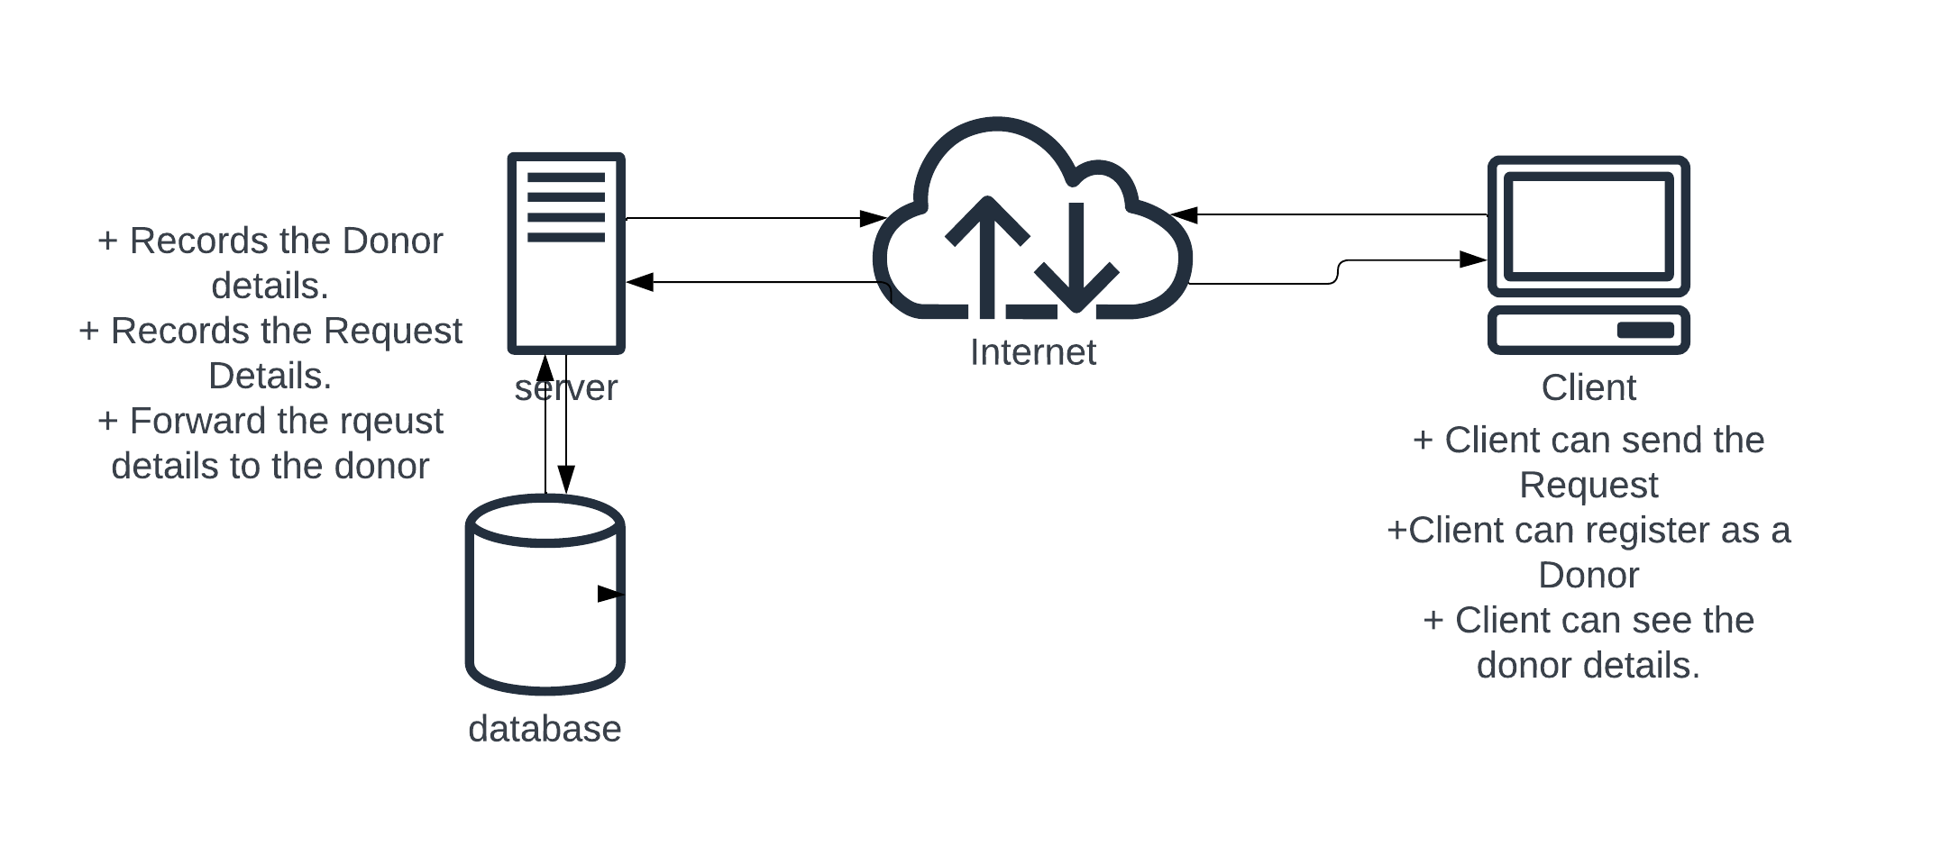
SYSTEM ARCHITECTURE
Educate
Empower
Excel
HICET

Slide 11
LIST OF MODULES
Admin Control
Donor Registration
Donor information
Request for the Donor
Educate
Empower
Excel
HICET

Slide 12
MODULE DESCRIPTION
Admin Control
In the Admin Panel, Admin able to add the user, delete the already existing users.
Also, admin able to post the Details of Blood Camp.
Educate
Empower
Excel
HICET

Slide 13
MODULE DESCRIPTION
Donor Registration
In this section, user able to register as a donor for themselves.
By Register as a donor, details will store in the Donor details table in the database and the Donor will get the notification through the Email. In email Id what they provide while the registration.
Educate
Empower
Excel
HICET

Slide 14
MODULE DESCRIPTION
Donor Information
In this section, people can get the Donor details like Name, Phone Number, Blood Group, and City.
By this details People those who are needed a blood can able to arrange blood easily.
Details are fetched from the Donor Details table in database.
Educate
Empower
Excel
HICET

Slide 15
MODULE DESCRIPTION
Request For Donor
By raise the request for blood in this application, the details will be forwarded to the donor those who are registered in the Application through the Email.
And the Request details will be stored in Request Details table in database for future reference.
Educate
Empower
Excel
HICET

Slide 16
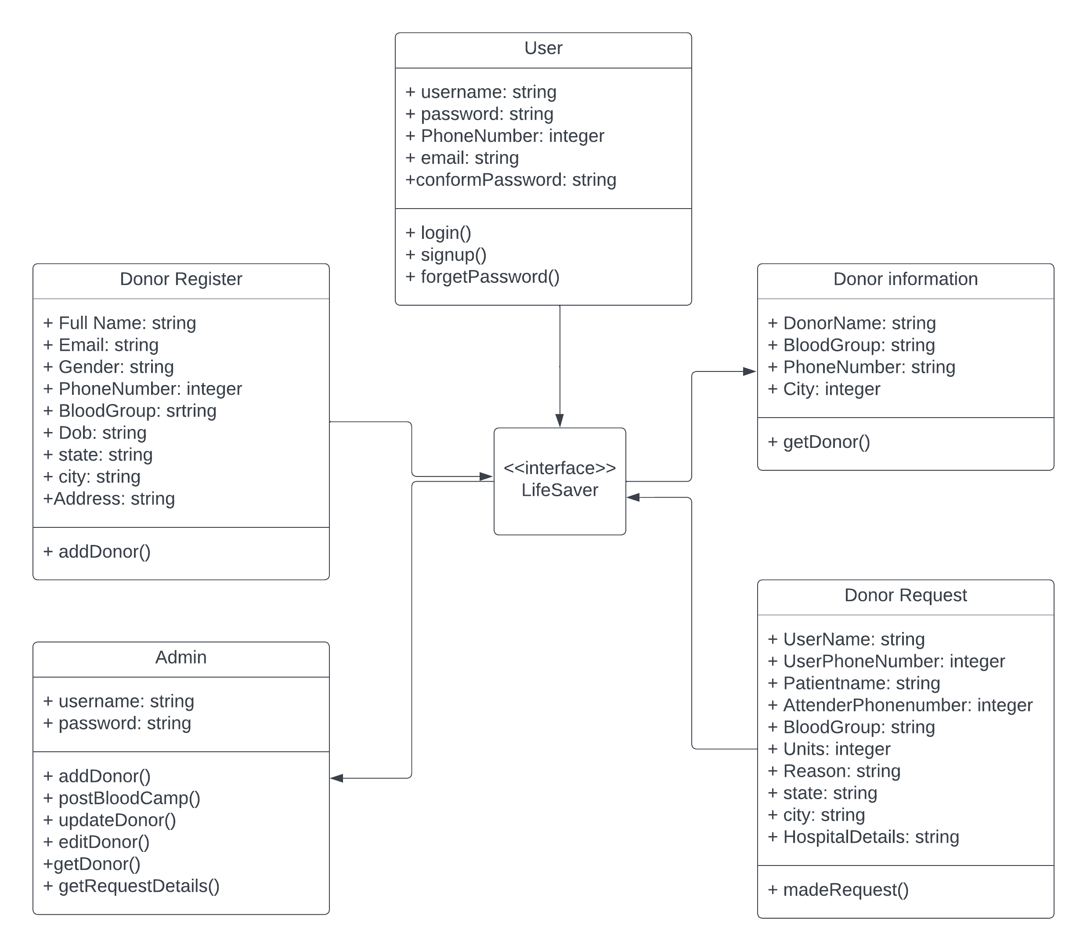
CLASS DIAGRAM
Educate
Empower
Excel
HICET

Slide 17
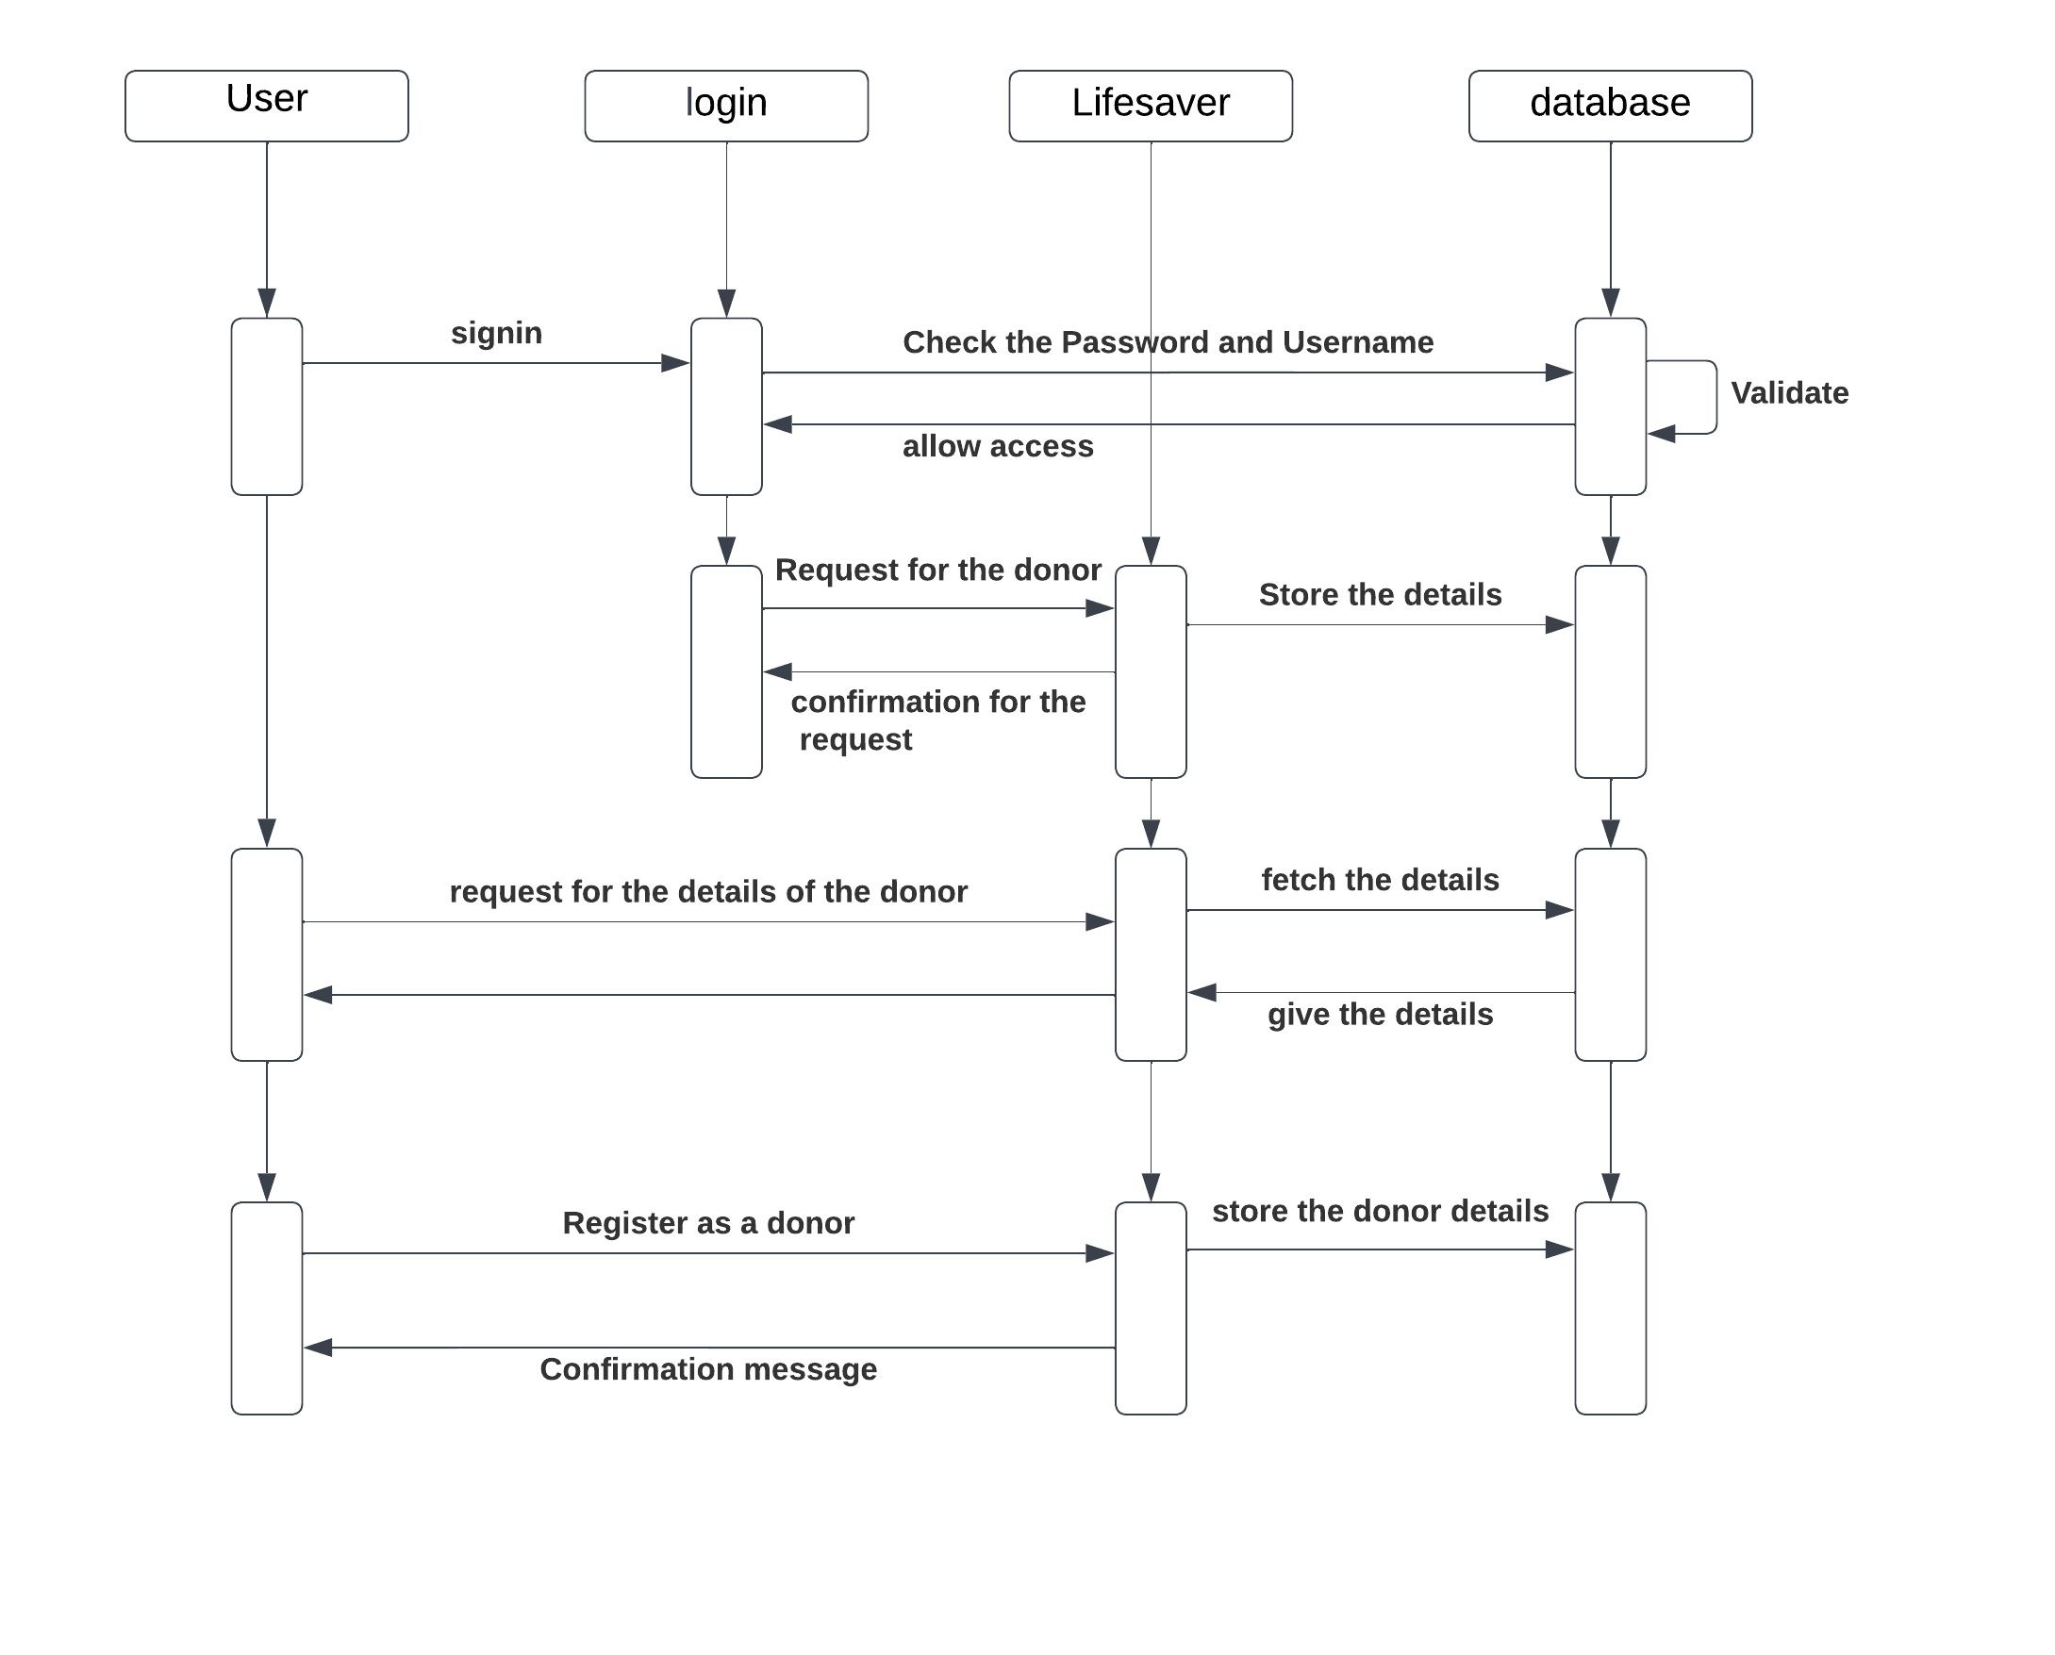
SEQUENCE DIAGRAM
Educate
Empower
Excel
HICET

Slide 18
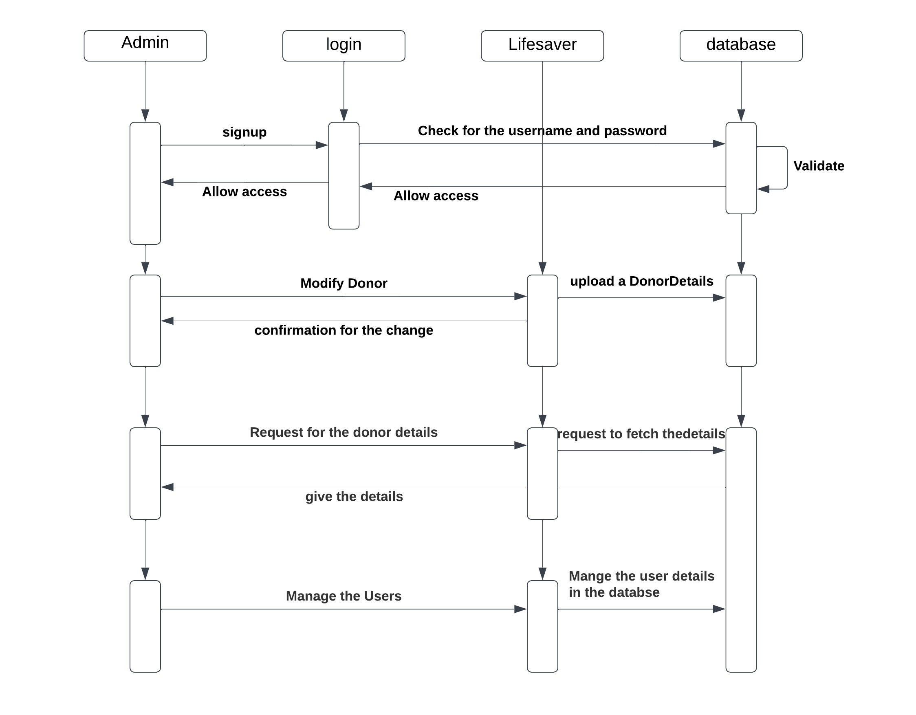
SEQUENCE DIAGRAM
Educate
Empower
Excel
HICET

Slide 19
CONCLUSION
In fact, every two seconds of every day, someone needs blood. Since blood cannot be manufactured outside the body and has a limited shelf life, the supply must constantly be replenished by generous blood donors.
By use of this application, People who needs a blood for emergency will get the blood easily.
Educate
Empower
Excel

Slide 20
QUERIES?
Educate
Empower
Excel

Slide 21
Thank you
Educate
Empower
Excel

